Slide 1
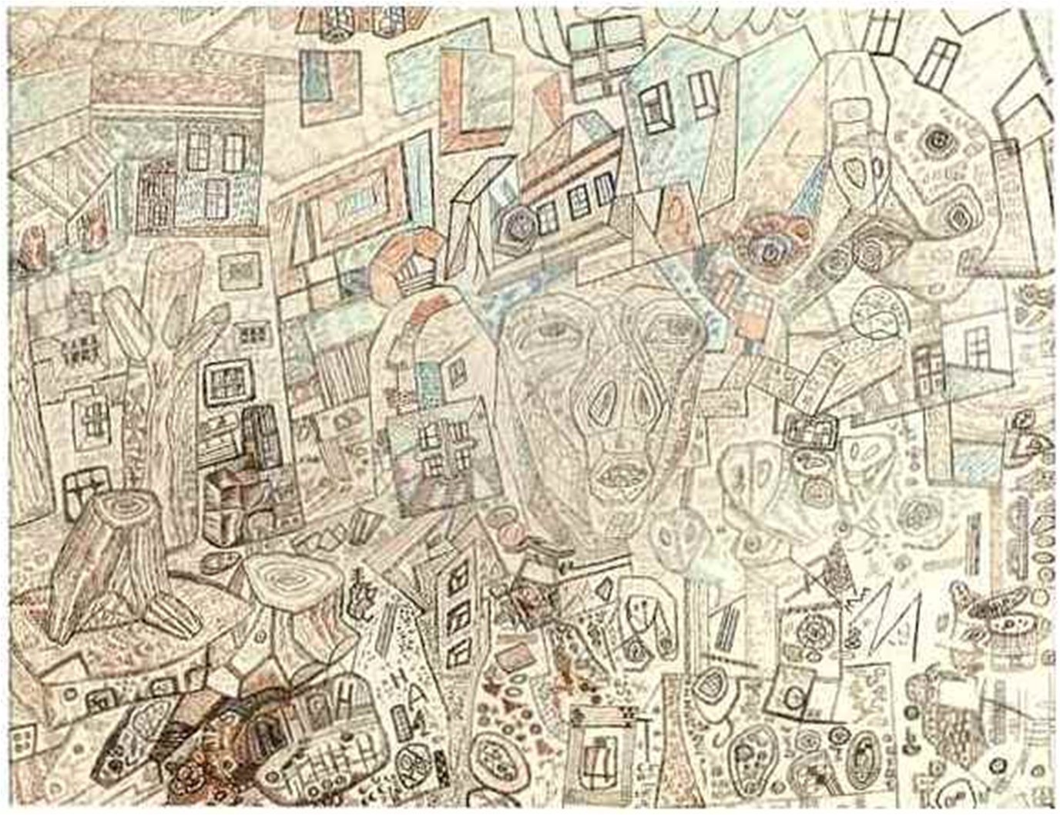
X-ray basic

Slide 2
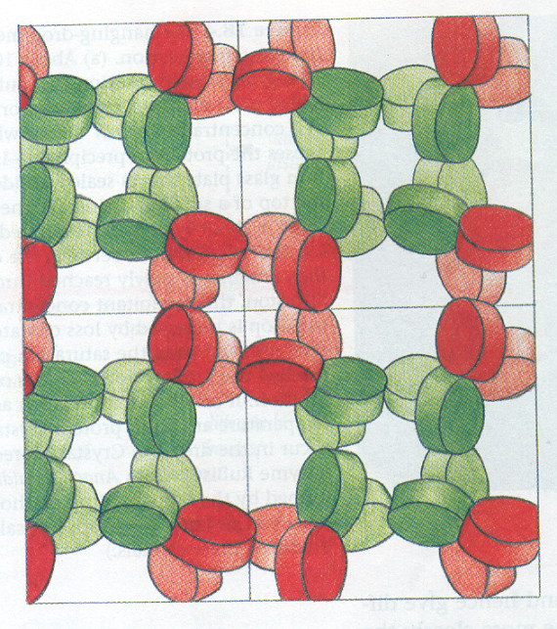
Protein crystal
20-80% solvent
Few crystal contents
It is possible to find atom coordinates only if the atom occupy the same position in (almost) all
Flexible parts of proteins cannot be solved

Slide 3
Result of X-ray experiment
1 1 1 -44 0 7 o 16.7 11.9 -14.0000 12.0000
1 1 1 -44 0 8 o 73.6 23.0 55.7000 20.9000
1 1 1 -44 0 9 o 109.8 9.6 90.7000 14.6000
1 1 1 -44 0 10 o 20.2 14.0 -7.4000 13.4000
1 1 1 -44 0 11 o 21.4 14.9 -11.5000 16.5000
1 1 1 -44 0 12 o 50.3 17.5 25.5000 11.2000
1 1 1 -44 0 13 o 252.6 6.4 459.6000 22.6000
1 1 1 -44 0 14 o 33.7 21.7 10.1000 23.6000
1 1 1 -44 1 7 o 44.8 14.8 17.7000 10.8000
1 1 1 -44 1 8 o 25.2 12.1 -12.3000 12.3000
1 1 1 -44 1 9 o 32.4 13.9 3.9000 11.3000
1 1 1 -44 1 10 o 92.5 8.8 65.0000 11.5000
1 1 1 -44 1 11 o 51.4 16.9 24.9000 14.1000
1 1 1 -44 1 12 o 74.9 10.8 44.2000 11.4000
1 1 1 -44 1 13 o 64.1 13.5 35.1000 11.8000
1 1 1 -44 1 14 o 96.8 9.2 71.8000 12.6000
1 1 1 -44 2 8 o 44.2 16.6 17.1000 14.0000
1 1 1 -44 2 9 o 80.8 11.2 51.8000 12.7000
1 1 1 -44 2 10 o 26.6 12.7 -11.4000 13.2000
1 1 1 -44 2 11 o 27.8 12.2 0.5000 9.2000
1 1 1 -44 2 12 o 120.1 8.9 109.7000 15.0000
1 1 1 -44 2 13 o 160.1 6.3 187.7000 14.1000
1 1 1 -44 2 14 o 31.0 13.4 2.5000 10.8000
1 1 1 -44 3 8 x ? ? ? ?
1 1 1 -44 3 9 o 27.6 11.6 2.7000 7.6000
………………………………………………………………
Structure factors
103 800 lines for PDB entry 3v6t, resolution 1.85 angstroms

Slide 4
Structure factors +
+ Phases (additional experiments or sample structure) =>
=> Draft electron density map =>
=> Computer optimisation =>
=> PDB MODEL

Slide 5
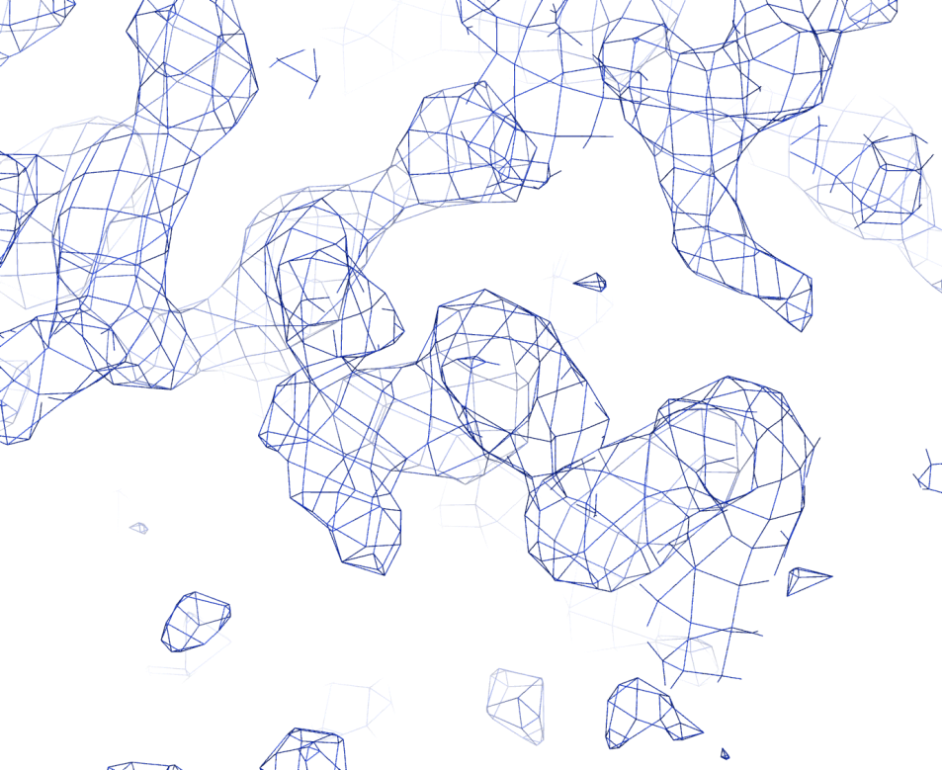
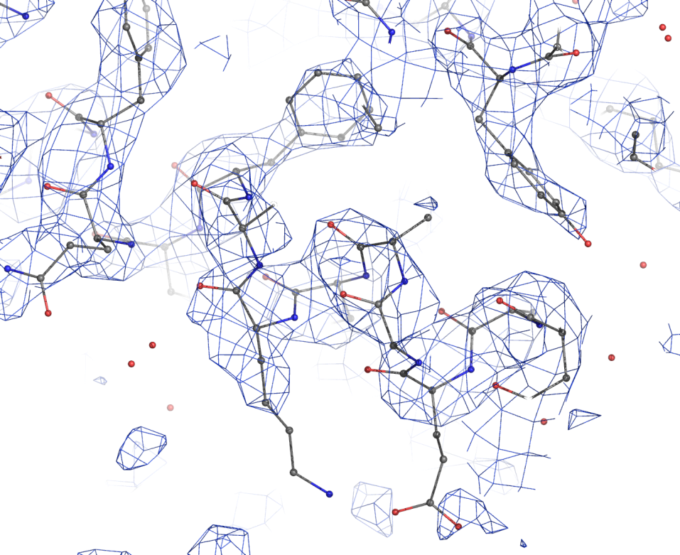
Electron density map
Protein chain is imbedded into electron density
Electron density map

Slide 6
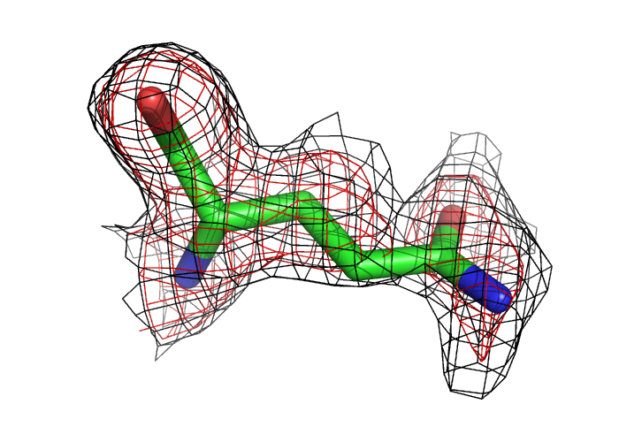
Comparing the PDB model with experimental data
Electron density map can be created and visualized if both file with STRUCTURE FACTORS and PDB MODEL are available.
Phases are taken from the PDB MODEL
Electron density for a particular residue shows if the reconstruction is good or bad

Slide 7
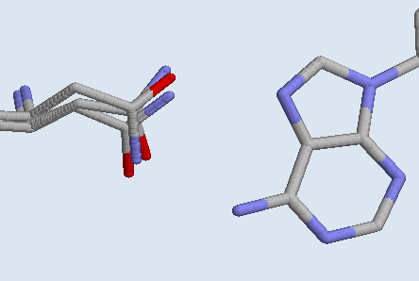
Hint for (6) task 2
Asn51
Atom ND2
no.2
Atom N7 –
H-acceptor
?
no.1
?
A103
Atom OD1
Atom N6 –
H-donor
Asn atoms OD1 and ND2 are located like in no.1 in structures of 36 other homeodomain-DNA complexes; like in no.2 – in only 2. Oxygen OD1 (H-acceptor ) against H-donor, and Nitrogen ND2 (H-donor) against acceptor form TWO H-bonds, inversion of theses atoms leads to ZERO H-bonds.
Thus, conformation 2 is supposed to be a mistake, which is caused by almost similar electron density around oxygen and nitrogen atoms. Such mistakes in protein structures are know as ‘Asn (Gln, His) inversions’

