Slide 1
Часть 2 Анализ трехмерных структур

Slide 2
Содержание второй части
Вторичная структура
Гидрофобные ядра
Структурные домены
Поверхности
Пространственное совмещение
Структурные классификации

Slide 3
Алгоритмы определения вторичной структуры

Slide 4
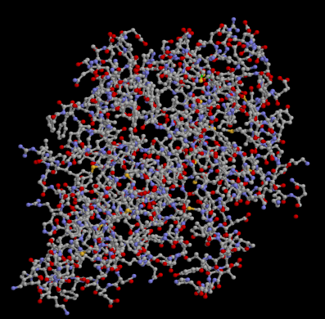
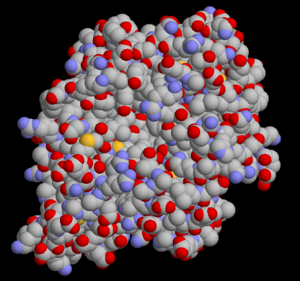
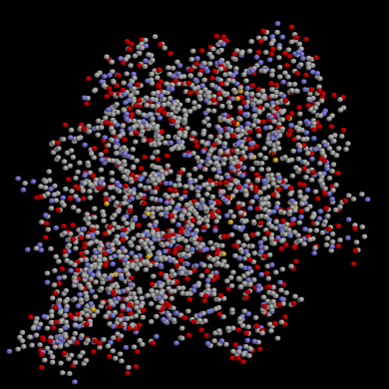
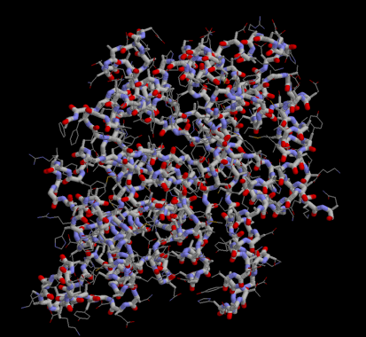
Как выглядит белок?

Slide 5
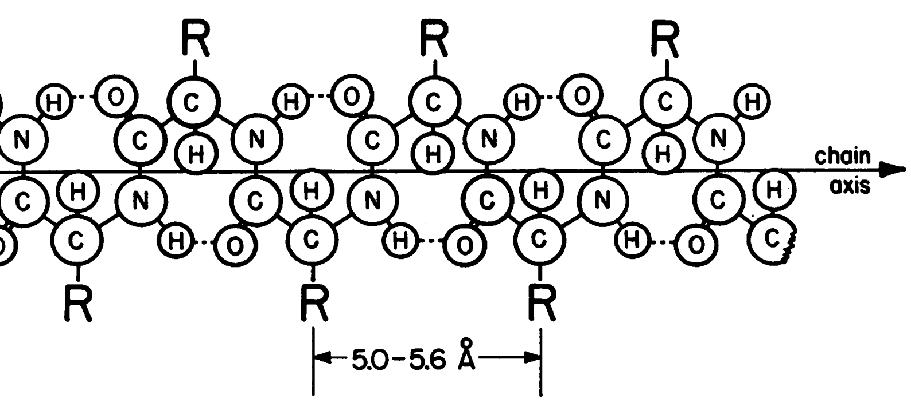
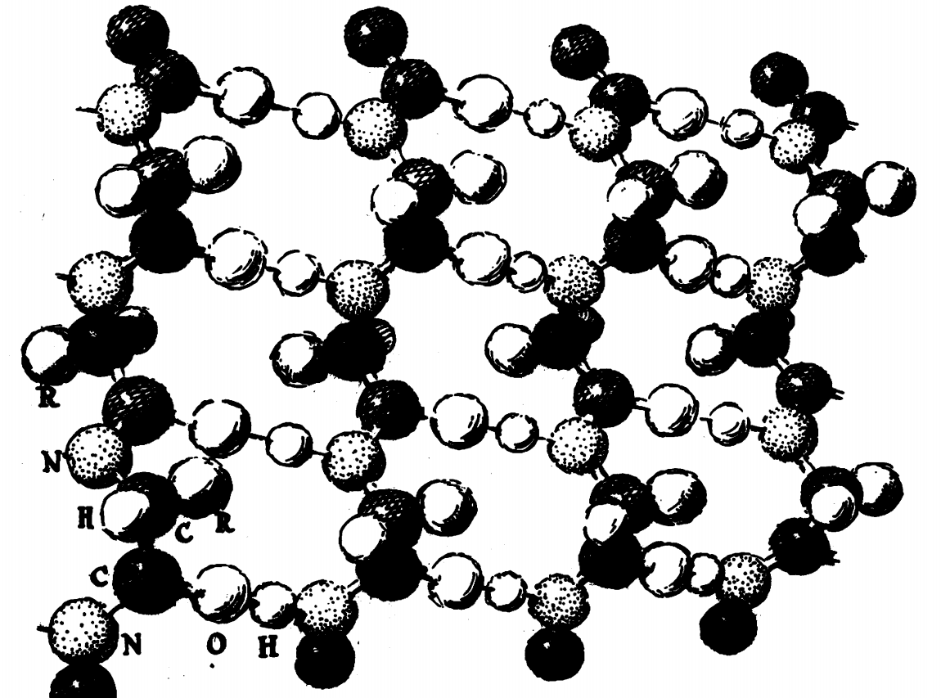
Pauling and Corey, 1951

Slide 6
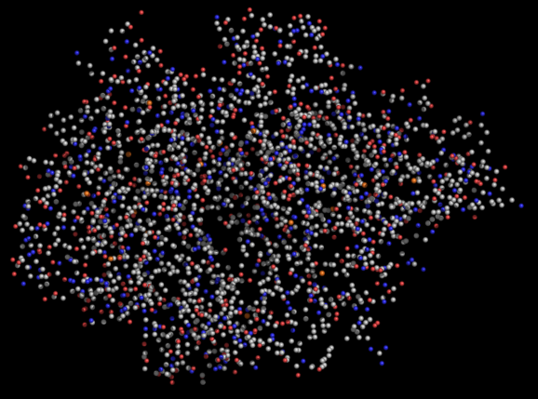
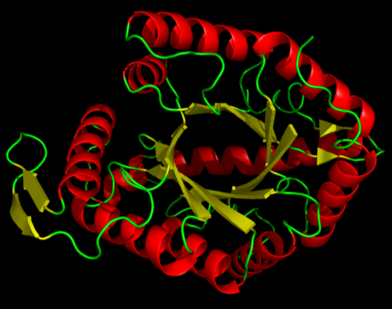
Постановка задачи
ATOM 1 N MET A 1 65.266 8.056 4.367
ATOM 2 CA MET A 1 65.196 8.000 5.806
ATOM 3 C MET A 1 63.737 8.186 6.154
ATOM 4 O MET A 1 63.070 8.989 5.509
ATOM 5 CB MET A 1 66.023 9.076 6.485
ATOM 6 CG MET A 1 66.327 8.769 7.909
ATOM 7 SD MET A 1 67.596 7.490 8.110
ATOM 8 CE MET A 1 68.730 8.059 6.902
ATOM 9 N LYS A 2 63.252 7.430 7.142
ATOM 10 CA LYS A 2 61.878 7.545 7.562
ATOM 11 C LYS A 2 61.898 8.008 8.995
ATOM 12 O LYS A 2 62.848 7.691 9.728
ATOM 13 CB LYS A 2 61.062 6.252 7.425
ATOM 14 CG LYS A 2 60.901 5.819 5.961
ATOM 15 CD LYS A 2 60.856 4.293 5.771
ATOM 16 CE LYS A 2 62.203 3.593 5.508
ATOM 17 NZ LYS A 2 62.059 2.135 5.327
ATOM 18 N PHE A 3 60.814 8.741 9.341
ATOM 19 CA PHE A 3 60.705 9.250 10.658
ATOM 20 C PHE A 3 59.358 8.945 11.298
ATOM 21 O PHE A 3 58.336 9.160 10.669
ATOM 22 CB PHE A 3 60.960 10.785 10.678
ATOM 23 CG PHE A 3 62.384 11.080 10.274
ATOM 24 CD1 PHE A 3 63.412 10.949 11.211
ATOM 25 CD2 PHE A 3 62.659 11.435 8.954
ATOM 26 CE1 PHE A 3 64.734 11.202 10.844
ATOM 27 CE2 PHE A 3 63.980 11.712 8.566
ATOM 28 CZ PHE A 3 64.988 11.569 9.519
ATOM 29 N GLY A 4 59.421 8.456 12.532
ATOM 30 CA GLY A 4 58.224 8.129 13.322
Задание: нарисовать вторичные структуры на доске

Slide 7
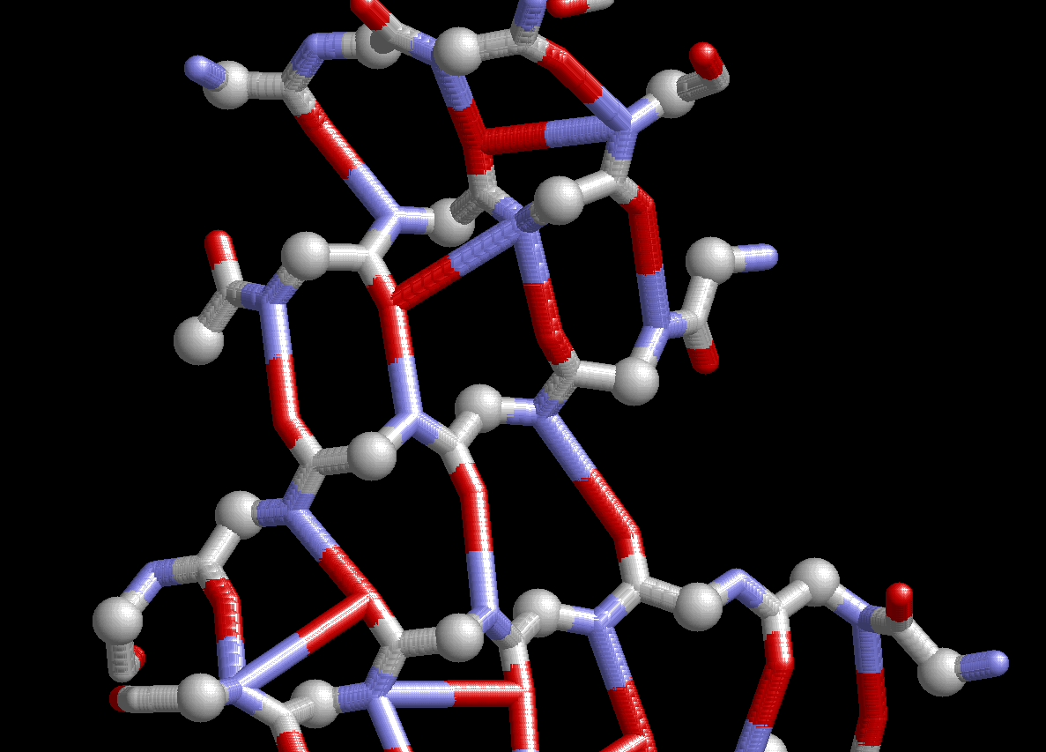

Slide 8
DSSP
Kabsch and Sander. Dictionary of Protein Secondary Structure: Pattern Recognition of Hydrogen-Bonded and Geometrical Features. Biopolymers, Vol. 22, 2577-2637 (1983).
Идея: “Using backbone ϕ, ψ angles or Cα positions requires the
adjustment of several parameters, e.g., four angles for a rectangle in the ϕ, ψ
plane for each type of secondary structure. In contrast, the presence or
absence of an H bond can be characterized by a single decision parameter,
a cutoff in the bond energy. Therefore, we base our secondary structure
recognition algorithm mainly on H-bonding patterns”.
E $=γ\text{Q}\text{1}\text{Q}\text{2}\left({\frac{1}{r(NO)}}_{}+{\frac{1}{r(CH)}}_{}−{\frac{1}{r\left(HO\right)}}_{}−{\frac{1}{r(NC)}}_{}\right)$
Hbond(i, j)=: [E < -0.5kcal/mole]
(связь между CO i-го остатка и NH j-го)

Slide 10
Паттерны DSSP
T: n-turn(i)=: Hbond(i,i+n), n = 3,4,5
T: n-turn(i)=: Hbond(i,i+n), n = 3,4,5
H: 4-helix(i,i+3) =: [4-turn(i-1) and 4-turn(i)]
T: n-turn(i)=: Hbond(i,i+n), n = 3,4,5
H: 4-helix(i,i+3) =: [4-turn(i-1) and 4-turn(i)]
G: 3-helix(i,i+2) =: [3-turn(i-1) and 3-turn(i)]
T: n-turn(i)=: Hbond(i,i+n), n = 3,4,5
H: 4-helix(i,i+3) =: [4-turn(i-1) and 4-turn(i)]
G: 3-helix(i,i+2) =: [3-turn(i-1) and 3-turn(i)]
I: 5-helix(i,i+4) =: [5-turn(i-1) and 5-turn(i)]
T: n-turn(i)=: Hbond(i,i+n), n = 3,4,5
H: 4-helix(i,i+3) =: [4-turn(i-1) and 4-turn(i)]
G: 3-helix(i,i+2) =: [3-turn(i-1) and 3-turn(i)]
I: 5-helix(i,i+4) =: [5-turn(i-1) and 5-turn(i)]
B:
Parallel Bridge(i,j) =: [Hbond(i-1,j) and Hbond(j,i+1)]
T: n-turn(i)=: Hbond(i,i+n), n = 3,4,5
H: 4-helix(i,i+3) =: [4-turn(i-1) and 4-turn(i)]
G: 3-helix(i,i+2) =: [3-turn(i-1) and 3-turn(i)]
I: 5-helix(i,i+4) =: [5-turn(i-1) and 5-turn(i)]
B:
Parallel Bridge(i,j) =: [Hbond(i-1,j) and Hbond(j,i+1)]
Antiparallel Bridge(i,j) =: [Hbond(i,j) and Hbond(j,i)] or
[Hbond(i-1,j+1) and Hbond(j-1,i+1)]
T: n-turn(i)=: Hbond(i,i+n), n = 3,4,5
H: 4-helix(i,i+3) =: [4-turn(i-1) and 4-turn(i)]
G: 3-helix(i,i+2) =: [3-turn(i-1) and 3-turn(i)]
I: 5-helix(i,i+4) =: [5-turn(i-1) and 5-turn(i)]
B:
Parallel Bridge(i,j) =: [Hbond(i-1,j) and Hbond(j,i+1)]
Antiparallel Bridge(i,j) =: [Hbond(i,j) and Hbond(j,i)] or
[Hbond(i-1,j+1) and Hbond(j-1,i+1)]
E:
ladder =: set of one or more consecutive bridges
of identical type
T: n-turn(i)=: Hbond(i,i+n), n = 3,4,5
H: 4-helix(i,i+3) =: [4-turn(i-1) and 4-turn(i)]
G: 3-helix(i,i+2) =: [3-turn(i-1) and 3-turn(i)]
I: 5-helix(i,i+4) =: [5-turn(i-1) and 5-turn(i)]
B:
Parallel Bridge(i,j) =: [Hbond(i-1,j) and Hbond(j,i+1)]
Antiparallel Bridge(i,j) =: [Hbond(i,j) and Hbond(j,i)] or
[Hbond(i-1,j+1) and Hbond(j-1,i+1)]
E:
ladder =: set of one or more consecutive bridges
of identical type
sheet =: set of one or more ladders
connected by shared residues
Приоритет: H, B, E, G, I, T

Slide 11
DSSP
1 1 A M 0 0 102 0, 0.0 85,-0.1 0, 0.0
2 2 A D + 0 0 135 83,-0.0 2,-0.3 2,-0.0
3 3 A Q S S- 0 0 128 81,-0.2 83,-0.3 76,-0.0
4 4 A F - 0 0 46 -2,-0.3 2,-0.4 81,-0.1
5 5 A E E -a 87 0A 94 81,-1.8 83,-2.2 -2,-0.3
6 6 A C E +a 88 0A 61 -2,-0.4 2,-0.3 81,-0.2
7 7 A I E -a 89 0A 9 81,-2.4 83,-2.8 -2,-0.5
8 8 A N > - 0 0 81 -2,-0.3 4,-2.6 81,-0.2
9 9 A V H > S+ 0 0 2 81,-0.3 4,-2.6 1,-0.2
10 10 A A H > S+ 0 0 48 2,-0.2 4,-1.9 1,-0.2
11 11 A D H > S+ 0 0 54 2,-0.2 4,-2.4 1,-0.2
12 12 A A H X S+ 0 0 0 -4,-2.6 4,-2.4 1,-0.2
13 13 A H H X S+ 0 0 42 -4,-2.6 4,-2.6 1,-0.2
14 14 A Q H X S+ 0 0 108 -4,-1.9 4,-2.2 2,-0.2
15 15 A K H <>S+ 0 0 32 -4,-2.4 5,-2.6 1,-0.2
16 16 A L H ><5S+ 0 0 13 -4,-2.4 3,-1.6 -5,-0.2
17 17 A Q H 3<5S+ 0 0 136 -4,-2.6 -1,-0.2 1,-0.3
18 18 A E T 3<5S- 0 0 88 -4,-2.2 -1,-0.3 -5,-0.2
19 19 A K T < 5S+ 0 0 191 -3,-1.6 -3,-0.2 -4,-0.3
20 20 A E < + 0 0 100 -5,-2.6 2,-0.3 -6,-0.2
21 21 A A - 0 0 8 -6,-0.8 2,-0.3 -9,-0.1
22 22 A V E -b 61 0A 45 38,-2.7 40,-2.7 -2,-0.3
23 23 A L E -b 62 0A 3 16,-0.5 18,-2.5 -2,-0.3
24 24 A V E -bc 63 41A 0 38,-2.9 40,-2.7 -2,-0.5
25 25 A D E -bc 64 42A 0 16,-2.8 18,-1.9 -2,-0.4
26 26 A I + 0 0 41 38,-2.3 39,-0.1 -2,-0.5
27 27 A R S S- 0 0 13 37,-0.3 -2,-0.1 1,-0.1
28 28 A D > - 0 0 50 1,-0.1 4,-2.6 4,-0.1
29 29 A P H > S+ 0 0 85 0, 0.0 4,-2.4 0, 0.0
30 30 A Q H > S+ 0 0 159 2,-0.2 4,-1.8 1,-0.2
31 31 A S H > S+ 0 0 36 1,-0.2 4,-0.8 2,-0.2
32 32 A F H >< S+ 0 0 8 -4,-2.6 3,-1.1 1,-0.2
33 33 A A H 3< S+ 0 0 37 -4,-2.4 74,-2.7 1,-0.3
34 34 A M H 3< S- 0 0 150 -4,-1.8 -1,-0.3 1,-0.3

Slide 12
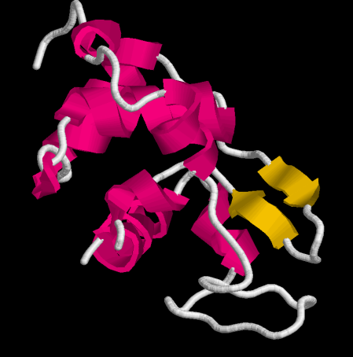
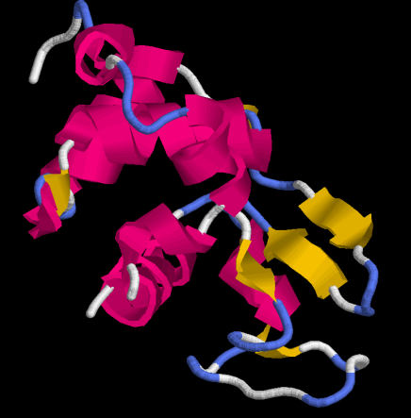
STRIDE
Frishman and Argos. Knowledge-based protein secondary structure assignment. Proteins, 23(4). 1995.
Идея: Использовать много параметров, оптимизировать детектор таким
образом, чтобы как можно лучше определять вторичные структуры
из обучающего множества.
Notes:
1at6

Slide 13
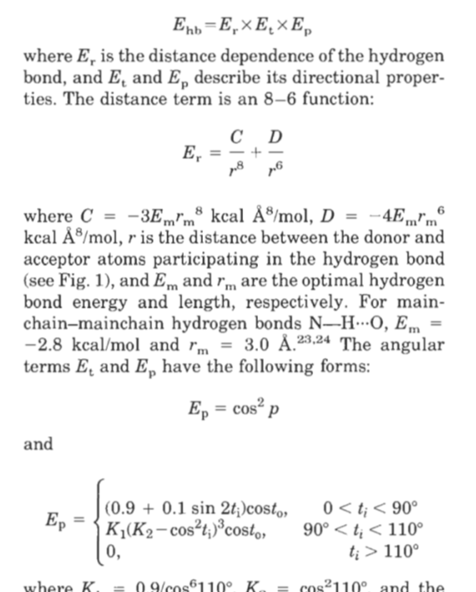
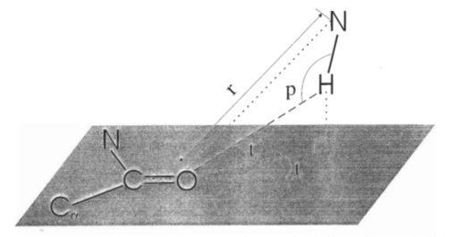
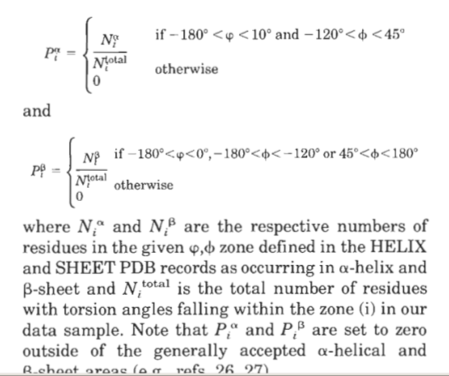
STRIDE
Frishman and Argos. Knowledge-based protein secondary structure assignment. Proteins, 23(4). 1995.
Идея: Использовать много параметров, оптимизировать детектор таким
образом, чтобы как можно лучше определять вторичные структуры
из обучающего множества.
Notes:
1at6

Slide 14
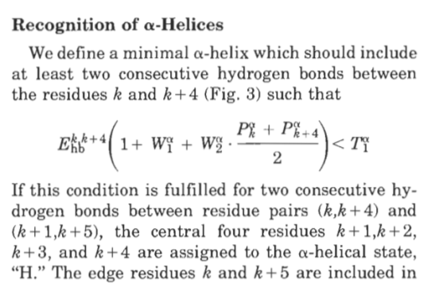
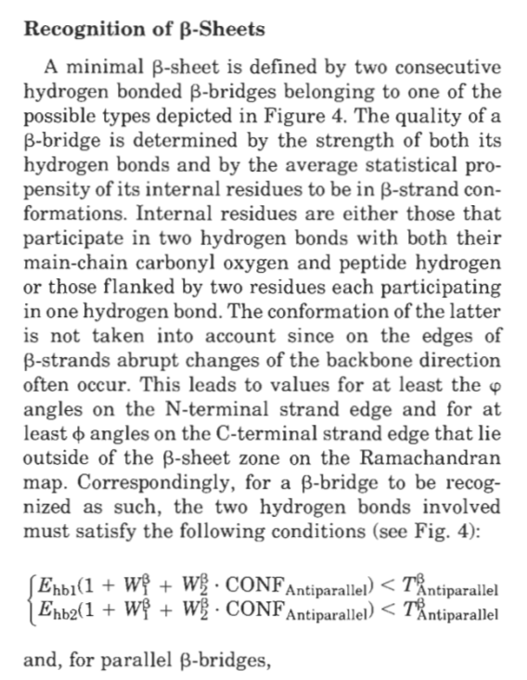
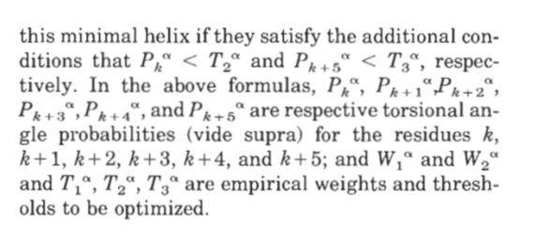
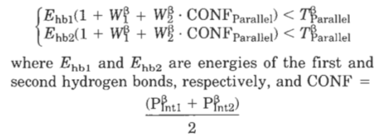
STRIDE
Frishman and Argos. Knowledge-based protein secondary structure assignment. Proteins, 23(4). 1995.
Notes:
1at6

Slide 15
STRIDE
LOC AlphaHelix VAL 9 A GLU 18 A
LOC AlphaHelix PRO 29 A MET 34 A
…
LOC Strand GLU 5 A ILE 7 A
LOC Strand VAL 22 A ASP 25 A
LOC Strand HIS 36 A ALA 37 A
…
REM
REM --------------- Detailed secondary structure assignment-
REM
REM |---Residue---| |--Structure--| |-Phi-| |-Psi-|
ASG MET A 1 1 C Coil 360.00 170.86
ASG ASP A 2 2 C Coil -94.97 14.07
ASG GLN A 3 3 C Coil -136.58 155.89
ASG PHE A 4 4 C Coil -105.88 163.36
ASG GLU A 5 5 E Strand -124.03 147.02
ASG CYS A 6 6 E Strand -89.61 131.95
ASG ILE A 7 7 E Strand -129.87 156.48
ASG ASN A 8 8 C Coil -88.60 168.19
ASG VAL A 9 9 H AlphaHelix -67.50 -29.30
ASG ALA A 10 10 H AlphaHelix -66.33 -42.80
ASG ASP A 11 11 H AlphaHelix -62.19 -48.83
ASG ALA A 12 12 H AlphaHelix -57.64 -44.42
ASG HIS A 13 13 H AlphaHelix -59.88 -41.08
ASG GLN A 14 14 H AlphaHelix -65.60 -44.33
ASG LYS A 15 15 H AlphaHelix -59.82 -39.01
ASG LEU A 16 16 H AlphaHelix -66.60 -47.17
ASG GLN A 17 17 H AlphaHelix -60.33 -36.02
Notes:
1at6

Slide 16
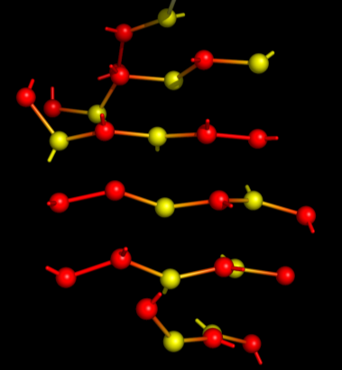
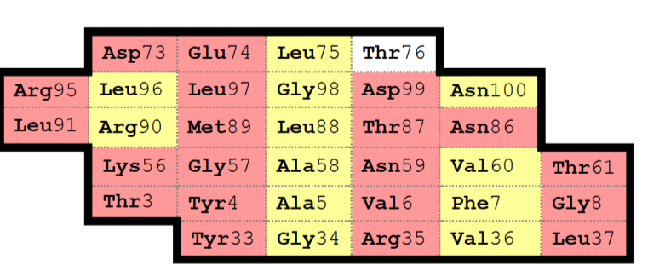
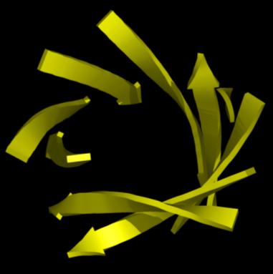
Карта бета-листа

Slide 17
Карта бета-листа
Ho H.K. et al. BetaSearch: a new method for querying β-residuemotifs. BMC Research Notes 2012, 5: 391.

Slide 18
Паттерны DSSP
T: n-turn(i)=: Hbond(i,i+n), n = 3,4,5
H: 4-helix(i,i+3) =: [4-turn(i-1) and 4-turn(i)]
G: 3-helix(i,i+2) =: [3-turn(i-1) and 3-turn(i)]
I: 5-helix(i,i+4) =: [5-turn(i-1) and 5-turn(i)]
B:
Parallel Bridge(i,j) =: [Hbond(i-1,j) and Hbond(j,i+1)]
Antiparallel Bridge(i,j) =: [Hbond(i,j) and Hbond(j,i)] or
[Hbond(i-1,j+1) and Hbond(j-1,i+1)]
E:
ladder =: set of one or more consecutive bridges
of identical type
sheet =: set of one or more ladders
connected by shared residues
Приоритет: H, B, E, G, I, T

Slide 19
DSSP
1 1 A M 0 0 102 0, 0.0 85,-0.1 0, 0.0
2 2 A D + 0 0 135 83,-0.0 2,-0.3 2,-0.0
3 3 A Q S S- 0 0 128 81,-0.2 83,-0.3 76,-0.0
4 4 A F - 0 0 46 -2,-0.3 2,-0.4 81,-0.1
5 5 A E E -a 87 0A 94 81,-1.8 83,-2.2 -2,-0.3
6 6 A C E +a 88 0A 61 -2,-0.4 2,-0.3 81,-0.2
7 7 A I E -a 89 0A 9 81,-2.4 83,-2.8 -2,-0.5
8 8 A N > - 0 0 81 -2,-0.3 4,-2.6 81,-0.2
9 9 A V H > S+ 0 0 2 81,-0.3 4,-2.6 1,-0.2
10 10 A A H > S+ 0 0 48 2,-0.2 4,-1.9 1,-0.2
11 11 A D H > S+ 0 0 54 2,-0.2 4,-2.4 1,-0.2
12 12 A A H X S+ 0 0 0 -4,-2.6 4,-2.4 1,-0.2
13 13 A H H X S+ 0 0 42 -4,-2.6 4,-2.6 1,-0.2
14 14 A Q H X S+ 0 0 108 -4,-1.9 4,-2.2 2,-0.2
15 15 A K H <>S+ 0 0 32 -4,-2.4 5,-2.6 1,-0.2
16 16 A L H ><5S+ 0 0 13 -4,-2.4 3,-1.6 -5,-0.2
17 17 A Q H 3<5S+ 0 0 136 -4,-2.6 -1,-0.2 1,-0.3
18 18 A E T 3<5S- 0 0 88 -4,-2.2 -1,-0.3 -5,-0.2
19 19 A K T < 5S+ 0 0 191 -3,-1.6 -3,-0.2 -4,-0.3
20 20 A E < + 0 0 100 -5,-2.6 2,-0.3 -6,-0.2
21 21 A A - 0 0 8 -6,-0.8 2,-0.3 -9,-0.1
22 22 A V E -b 61 0A 45 38,-2.7 40,-2.7 -2,-0.3
23 23 A L E -b 62 0A 3 16,-0.5 18,-2.5 -2,-0.3
24 24 A V E -bc 63 41A 0 38,-2.9 40,-2.7 -2,-0.5
25 25 A D E -bc 64 42A 0 16,-2.8 18,-1.9 -2,-0.4
26 26 A I + 0 0 41 38,-2.3 39,-0.1 -2,-0.5
27 27 A R S S- 0 0 13 37,-0.3 -2,-0.1 1,-0.1
28 28 A D > - 0 0 50 1,-0.1 4,-2.6 4,-0.1
29 29 A P H > S+ 0 0 85 0, 0.0 4,-2.4 0, 0.0
30 30 A Q H > S+ 0 0 159 2,-0.2 4,-1.8 1,-0.2
31 31 A S H > S+ 0 0 36 1,-0.2 4,-0.8 2,-0.2
32 32 A F H >< S+ 0 0 8 -4,-2.6 3,-1.1 1,-0.2
33 33 A A H 3< S+ 0 0 37 -4,-2.4 74,-2.7 1,-0.3
34 34 A M H 3< S- 0 0 150 -4,-1.8 -1,-0.3 1,-0.3

Slide 20
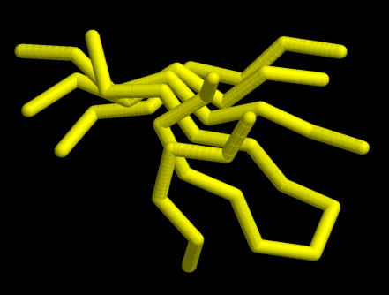
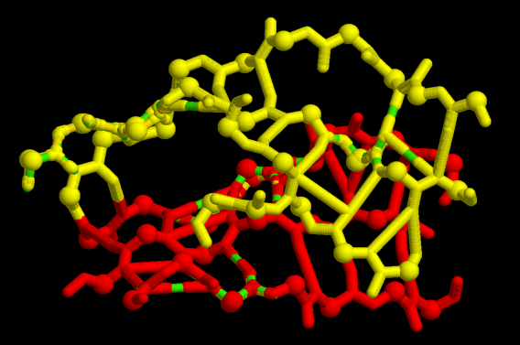
Paired residues, beta-buldges
Нерегулярность
Notes:
1dfm_A
1ok0_A

Slide 21
Paired residues, beta-buldges
Нерегулярность
N | arg68 | O | --- | N | tyr69 | O | --- | N | leu70 | O | --- | N | ala71 | O | --- | N | arg72 | O
 | = | \ |  | | | = | | |  |  | = |  |  | | | = | | |  |  | =
O | tyr37 | N | --- | O | val36 | N | --- | O | val35 | N | --- | O | lys34 | N | --- | O | val33 | N | --- | O | thr32 | N | --- | O | val31 | N
 | = | | |  |  | = |  |  | | | = |  |  |  | = |  |  | | | = | | |  |  | = |  |  | | | = | |
N | thr41 | O | --- | N | glu42 | O | --- | N | gly43 | O | --- | N | cys45 | O | --- | N | tyr46 | O | --- | N | ala47 | O | --- | N | val48 | O
N | arg68 | O | --- | N | tyr69 | O | --- | N | leu70 | O |  |  | --- |  |  | N | ala71 | O | --- | N | arg72 | O
 | = | \ |  | | | = | | |  |  | = |  |  |  |  |  |  | | | = | | |  |  | =
O | tyr37 | N | --- | O | val36 | N | --- | O | val35 | N |  |  | --- |  |  | O | lys34 | N | --- | O | val33 | N | --- | O | thr32 | N | --- | O | val31 | N
 | = | | |  |  | = |  |  | | | = |  |  |  |  |  |  |  | = |  |  | | | = | | |  |  | = |  |  | | | = | |
N | thr41 | O | --- | N | glu42 | O | --- | N | gly43 | O | --- | N | leu44 | O | --- | N | cys45 | O | --- | N | tyr46 | O | --- | N | ala47 | O | --- | N | val48 | O
Notes:
1dfm_A
1ok0_A

Slide 22
Гребни (crests)

Slide 23
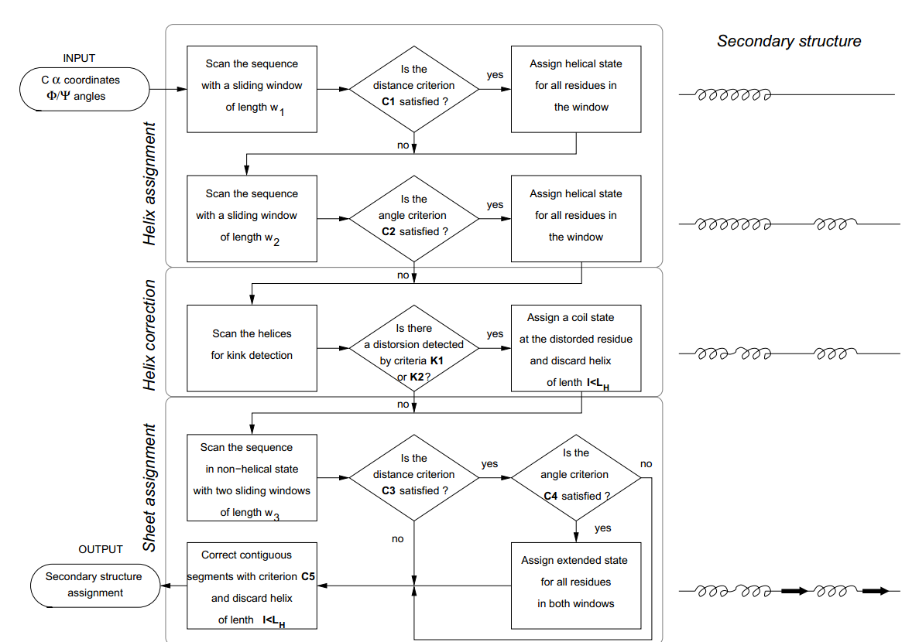
KAKSI
Martin, Letellier, Marin, Taly, de Brevern and Gibrat. Protein secondary structure assignment revisited: a detailed analysis of different assignment methods. BMC Structural Biology. 5(17). 2005.

Slide 24
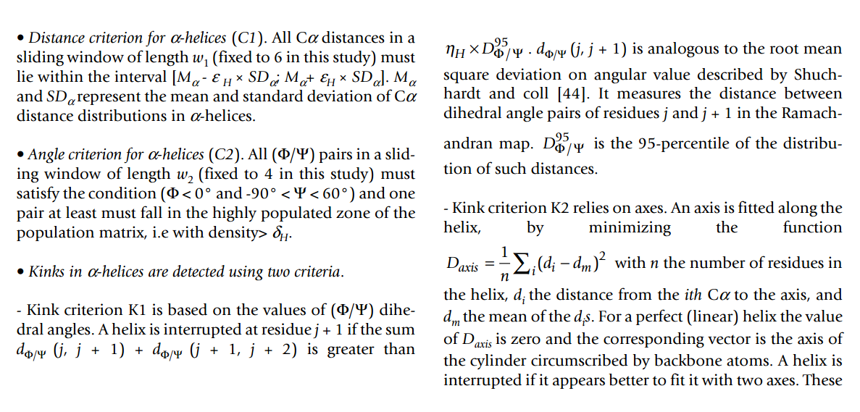
KAKSI
Martin, Letellier, Marin, Taly, de Brevern and Gibrat. Protein secondary structure a ssignment revisited: a detailed analysis of different assignment methods. BMC Structural Biology. 5(17). 2005.

Slide 25
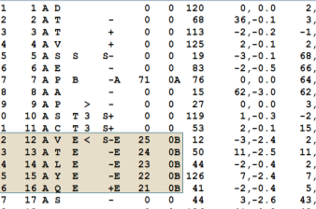
Sheep: Sheet Puzzle

Slide 26
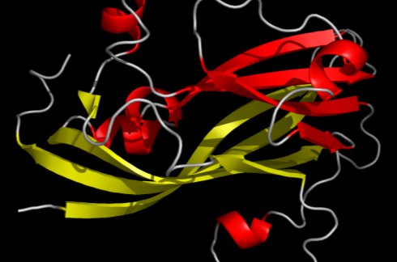
Тестирование
DSSP
Stride
SheeP

Slide 27
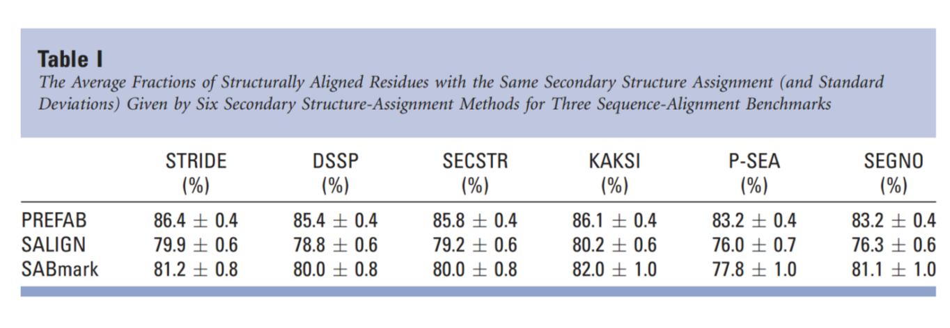
Тестирование
Zhang, Dunker and Zhou. Assessing secondary structure assignment of protein structures by using pairwise sequence-alignment benchmarks. Proteins, 71. 2008.
METYAVFGNPIAHSKSPFIHQQFAQQLNIEHPYGRVLAPIN
---EEEED-------HHHHHHHHHHHX-----EEEED----
MDLYAVWGNPIAQSKSPLIQNKLAAQTHQTMEYIAKLGDLD
-EEEEEED-------HHHHHHHHHHX----EEEEEED----

Slide 28
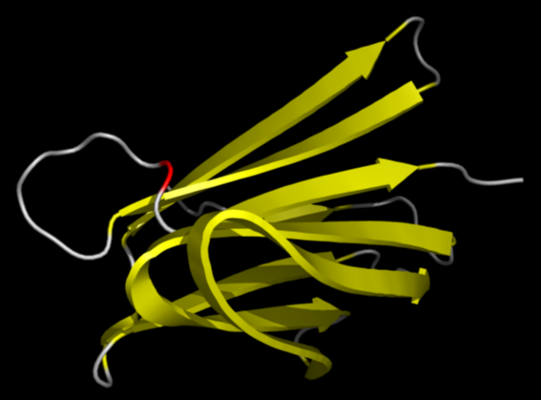
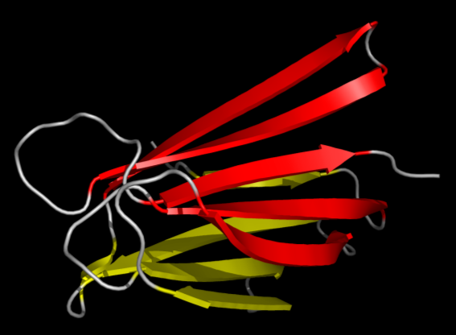
Тестирование
DSSP
SheeP

Slide 29
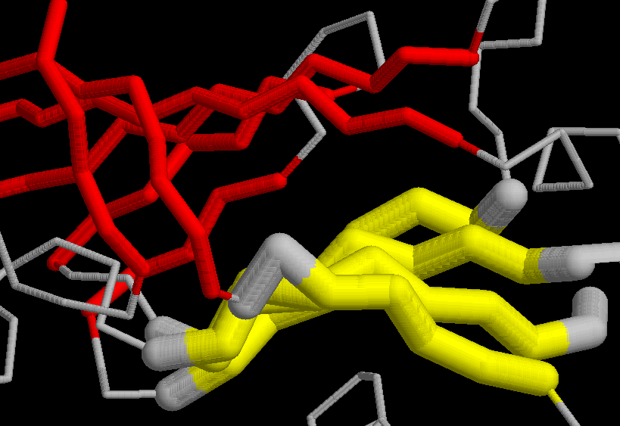
Тестирование: PALSSE
1bhg A:22-225
1a3q A:227-327
Notes:
Желтый, красный – листы как правильно
Жирный – 1 лист из PALSSE

Slide 30
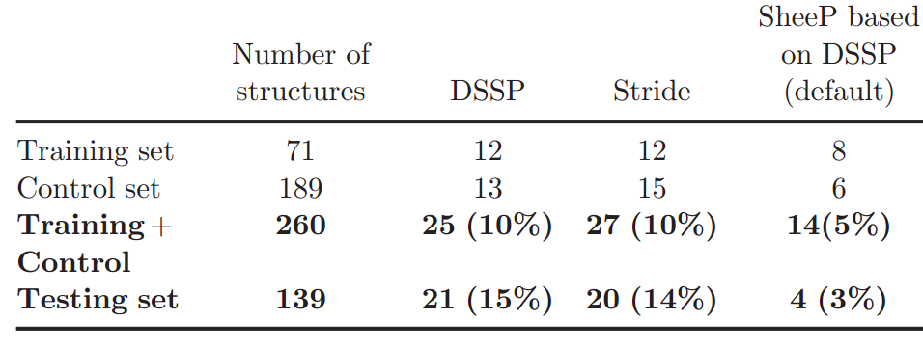
Тестирование
Частота ошибок, допускаемых программами DSSP, Stride и SheeP
Aksianov, Alexeevski. SheeP: A Tool for Description of β-Sheets in Protein 3D Structures. Journal of Bioinformatics and Computational Biology, 2012. 10(2)

Slide 31
Все

