Slide 1
Structural Domains in Proteins
PHAR 201/Bioinformatics I
Philip E. Bourne
Department of Pharmacology, UCSD
pbourne@ucsd.edu
Thanks to Stella Veretnik

Slide 2
Agenda
What is a 3D domain?
Why are domains important?
Example manual methods
Example automated methods
Comparison of manual vs. automated methods
How we might do better

Slide 3
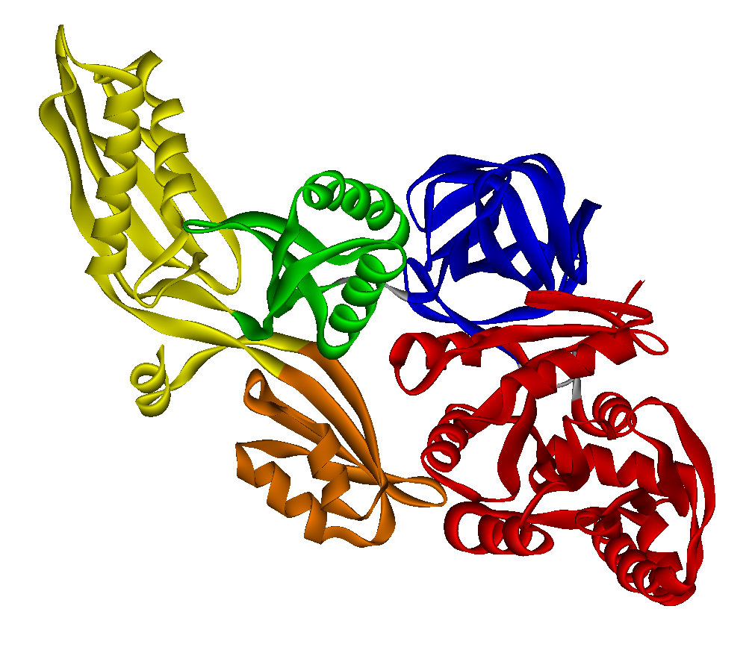
What is a Domain?
A domain is a fundamental structural, functional and evolutionary unit of a protein: it is the smallest unit that captures features of the entire protein
Compact
Stable
Has hydrophobic core
Folds independently **
Performs specific function
Can be put together in different combinations with other domains
Evolution works on the level of domain
Corresponds with intron-exon boundaries in DNA (debatable)
** Non-contiguous domains
What is a Domain?

Slide 4
What is a Domain?
protein-protein complex
protein-DNA/RNA complex
secondary structure element
structural motif
(few secondary structures)
structural domain
protein structure
residues
complexity
reductionism
reasonable region of complexity
Building blocks in the region of ‘reasonable complexity’ have several qualities:
blocks are sufficiently unique and yet they reoccur in different structures
protein contains small number of such blocks, simple to reconstruct the protein from its basic units
such blocks make a lot of biological sense in terms of evolution, structure compactness and functionality
What is a Domain?

Slide 5
Why are Domains Important?
Analysis of protein structure begins with its decomposition into basic structural units
Comparison of protein sequences often is confined to the region of the sequence, these regions often correspond to structural domains
Prediction of protein function is based on protein domains
Structural classifications are constructed using domains as building blocks
Why are Domains Important?

Slide 6
Can we unambiguously and consistently identify domains in structures?
One way of answering this question is by comparing methods
Methods fall into two categories:
  Manual – Author, SCOP, CATH
  Automatic – e.g. DomainParser, PDP, PU, NCPI
Characterizing Domain Assignment Methods

Slide 7
Manual Methods for Domain Assignment
SCOP : Structural Classification Of Proteins is a manually curated database; orders structures hierarchically into Classes, Folds, Superfamilies and Families according to their evolutionary, structural and functional relationships. Domains are defined as largest reoccurring units in the structure.
CATH : hierarchical classification of protein domain structures. Clusters proteins at four major levels Class (C), Architecture (A), Topology (T), Homologous superfamily (H). Uses both manual and automated methods (DETECTIVE, PUU, DOMAK and SSAP). Domains have to form a structurally compact and sensible unit.
AUTHORS : assigned by the authors of the solved structure. Authors of the structure tend to promote small structural regions to the status of domain if they carry specific functions.
Details on Manual Methods

Slide 8
Examples where there is no agreement among manual methods
Disagreement Among Manual Methods

Slide 9
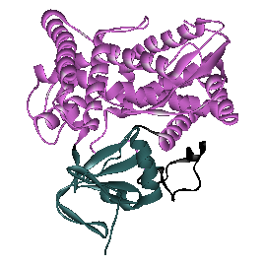
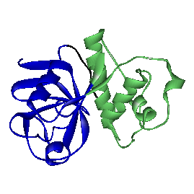
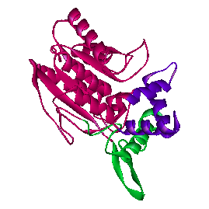
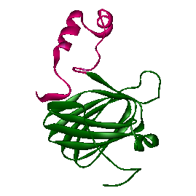
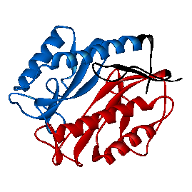
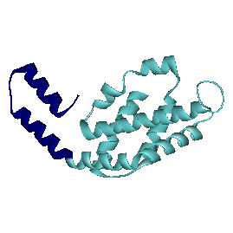
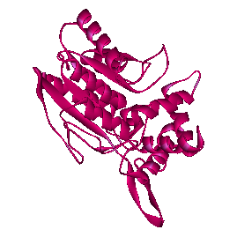
1caub
1pcpa/1pcpl
1tahb
AUTHORS method: cases of disagreement (overcut)
AUTHORS:2
SCOP, CATH: 1
AUTHORS: 2
SCOP, CATH: 1
CATH, SCOP:1 AUTHORS: 3
2hpd
1ppn
1mat
AUTHORS:2
SCOP, CATH: 1
AUTHORS:2
SCOP, CATH:1
AUTHORS:2
SCOP, CATH: 1
Disagreement Among Manual Methods

Slide 10
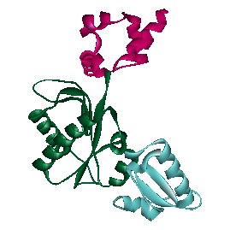
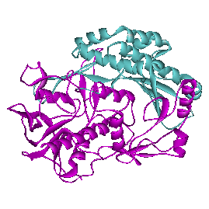
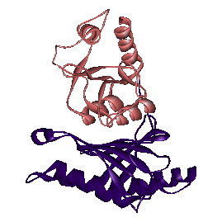
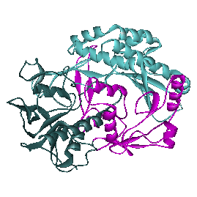
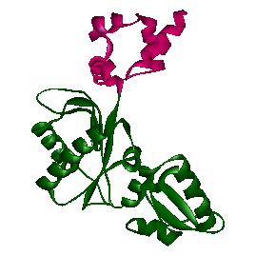
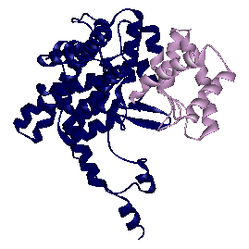
5fbpa
1bpb
SCOP method: cases of disagreement (undercut)
SCOP: 1 AUTHORS, CATH: 2
AUTHORS, CATH: 3
SCOP: 2
2cts
SCOP: 1 AUTHORS, CATH: 2
1gal
AUTHORS, CATH: 3
SCOP: 2
Disagreement Among Manual Methods

Slide 11
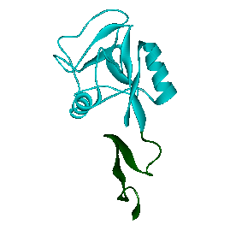
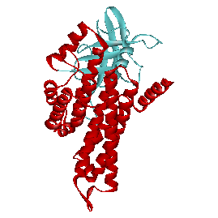
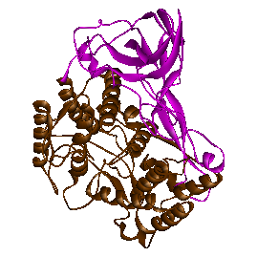
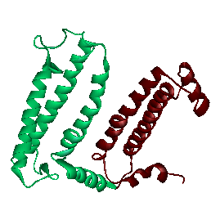
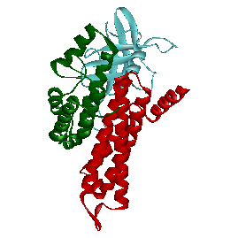
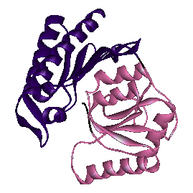
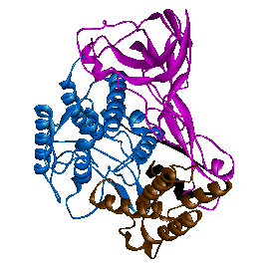
1prcl
2hhm
1esl
CATH method: cases of disagreement (overcut and undercut)
CATH: 2,AUTHORS, SCOP: 1
CATH: 1, AUTHORS, SCOP: 2
CATH: 2, AUTHORS, SCOP: 1
EGF domain
3mdda
1lla
CATH:3
AUTHORS, SCOP:2
CATH:2
AUTHORS, SCOP: 3
Disagreement Among Manual Methods

Slide 12
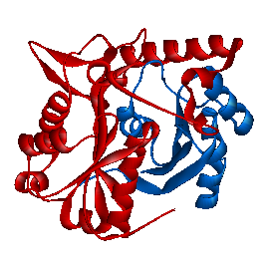
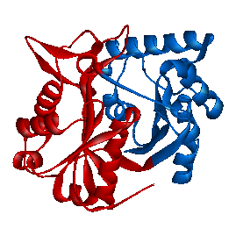
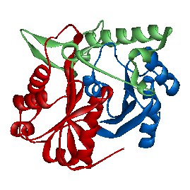
Are there cases when the three manual methods all assign different number of domains?
NO.
However, there are cases where domain boundaries differ among all three methods.
(Thiolase)
3-layer sandwich
1pxta/ SCOP
1pxta/ AUTHORS
1pxta/ CATH
Disagreement Among Manual Methods

Slide 13
Why are there disagreements among manual methods as to how to partition protein into domains?
Multiple aspects contribute to the concept of structural domains:
  evolutionary aspect (recurrence of domain in different contexts)
  structural aspect (compactness/independent folding of domain)
  functional aspect (ability to carry function).
Disagreement Among Manual Methods

Slide 14
Summary of manual methods:
AUTHORS
SCOP
CATH
structural motif
(few secondary structures)
protein-protein
protein-DNA/RNA complex
structural domain
secondary structure
domain combinations
protein structure
residues
complexity
reductionism
Three expert approaches exist for assigning structural domains based on 3D structure:
each one is guided by different (but overlapping) set of concepts of what constitute a structural domain.
SCOP tends to identify large units as domains, these units clearly can be broken down further into compact structural units.
AUTHORS tend to subdivide structures into small regions, particularly if such regions can be associated with function. Often such units appear more like part of the domain (i.e. motif).
CATH method is most “middle of the road”: it puts stress on structure of the unit, thus producing most consistent set of domains in terms of size and compactness distribution
Summary of Manual Methods

Slide 15
Automatic Methods for Domain Assignment

Slide 16
Why we need automatic methods for domain assignments?
Fast annotation of new structures: Manual methods such as SCOP and CATH are chronically behind in the assignments – compounding problem
Consistent domain assignment: In principle automatic domain assignments should be consistent as all the rules as pre-set and there is no human intervention at any step of the process (some assignments will be consistently wrong, however)
Details on Automatic Methods

Slide 17
How do automatic methods work?
3D-coordinates of chain
Parameters involved
Make domains
by partitioning chain into smaller units
Make domains by putting together primitive units of secondary structure
Maximize hydrophobic core of the unit
Maximize compactness of the unit
Find mechanical hinge points between units
Minimize interface area between units
Step 1
Top-down approach
Bottom-up approach
Minimum size of unit
Maximize globularity
Minimize cutting through secondary structures
Maximum number of discontinuous fragments within the domain
Step 2
Evaluate each potential domain using set of parameters (accept or reject given assignment)
Predicted domains
Details on Automatic Methods

Slide 18
Two steps of algorithm design:
Step A
Step B
Train the algorithm
compare predicted domain assignments to “correct” domain assignments
Tune parameters till the best level of prediction is achieved
Validate the performance
run the algorithm of an independent set of data
Report % of correctly partitioned proteins
Is not typically done!
Use expert data for domain assignments
Use different sets of expert data in two steps
A problem: different algorithms use different experts assignments for training and validation.
More seriously, there is no good objective way to compare the performance of different methods, as each uses different dataset for validation.
Algorithms will reflect same propensities toward domain assignments as the expert method they rely upon.
Details on Automatic Methods

Slide 19
Relative Performance of Automated Methods using a Consensus Benchmark Dataset
Four most recent/available methods were used in analysis:
PDP, DomainParser, PUU and method by NCBI.
Details on Automatic Methods – Relative Performance

Slide 20
Some insights from looking at automatic domain assignments:
Maximizing ratio of intra- /inter-domain contacts is a chief principle in algorithmic assignments and work well for ‘standard’ cases. As more complex structures are solved, more cases of ‘unusual’ architecture are uncovered. These tend to defy our basic rules.
It is possible to include more parameters and tune them better to avoid some obvious cases of overcuts:
penalize splitting secondary structure elements (some cutting of
secondary structures is essential to obtain ‘correct’ domain, but this feature should be carefully balanced)
penalize domains consisting from too many short fragments (excessive fragmentation may result in very compact, but biologically unfeasible domains)
improve the ability to recognize ‘classical’ folds (this will improve recognition of very small and very large domains for which contact density may be misleading)
Insights from Automatic Methods

Slide 21
It is very difficult to improve the cases of undercut, as they are result of significant interactions within domain interface.
Our observations indicate that majority of the undercut cases involves β-class domains: β-sheets and β-stands cause significant interactions not only within domain but also between residues of the adjacent domains. This phenomenon tricks most automatic methods (but not experts!).
In order to be able to conceptualize when it is justified to separate structural region with significant interactions into separate domains we need to:
better understanding domain –domain interfaces
include of additional information, such as sequence alignments and recurrence of architectures
Typically algorithms partition structure in a similar way, it is how far the structure is partitioned that differs among methods.
An ideal output from an algorithm would give several structure partitions at different level of refinement (less domains -> more domains or gross partitioning -> fine partitioning). Couple of algorithms of that nature appeared so far…
Insights from Automatic Methods

Slide 22
Example of One Automated Method in Detail: DomainParser

Slide 23
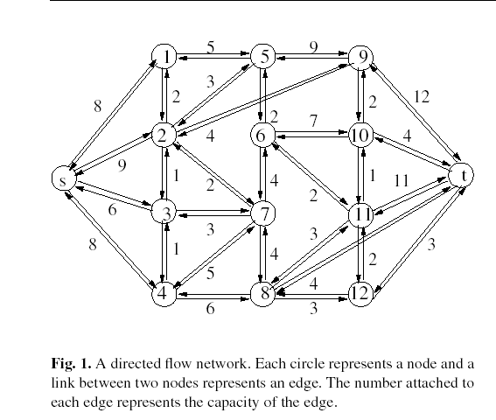
Domain Parser: domain decomposition using graph-theoretical approach
Top-down approach
Xu et al. (2000) Protein domain decomposition using graph-theoretical approach Bioinformatics 16:1091-1104
Model: Network flow problem
Represent each residue as a node in the graph
Represent contacts between residues as edges connecting nodes: strength of the interaction between two residues is reflected by the capacity (weight) of the edge connecting two nodes.
Solution: Divide network into two parts in such a way that the edge capacity across the division is minimal (i.e. find the bottleneck of the network)
The method will be iteratively apply to each sub-graph until termination condition is reached (min. size, globularity, etc)
Automatic Method – Domain Parser

Slide 24
Domain Parser: domain decomposition using graph-theoretical approach
Find all solution for a given graph, then systematically repeat the process for different positions of S and T.
Create artificial start node S (source) and end node T (sink).
Find a minimum cut: a set of edges (with lowest capacity) whose removal leaves no path from S (source) to T (sink)
Solve using Ford-Fulkerson algorithm (repeatedly finding direct path from S to T, by increasing flow along the way by some minimal value)
Collect all feasible domain assignments and evaluate their fitness using a list of parameters.
domain A
domain B
Automatic Method – Domain Parser

Slide 25
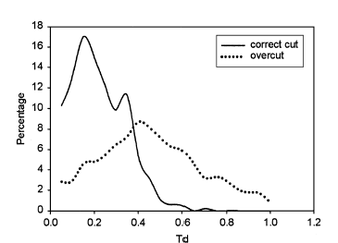
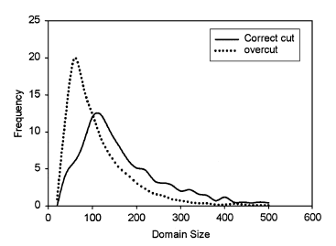
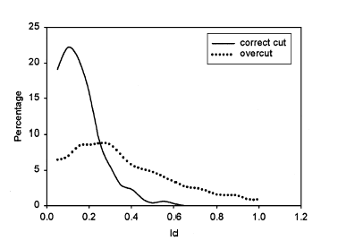
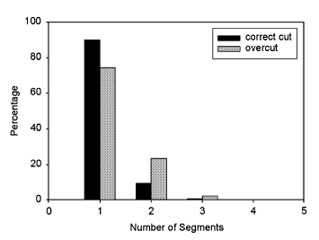
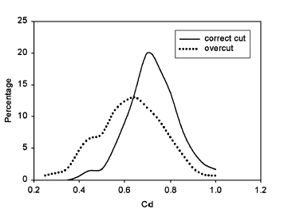
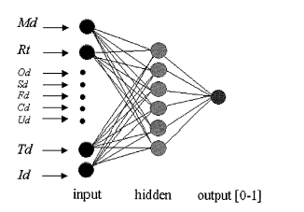
Domain Parser: domain decomposition using graph-theoretical approach
Evaluation schema:
Investigate biologically “sensible” domains (assigned by experts) and randomly generated domains. Look at the behavior of relevant biological properties in two sets: ‘true’ domains will have different set of characteristics than randomly assigned domains.
size/volume of interface
relative motion between domains
number of segments
compactness
Train neural network using all parameters
Output is given as a probability[0-1]
domain size

Slide 26
Comparison of Automated vs. Manual Methods

Slide 27
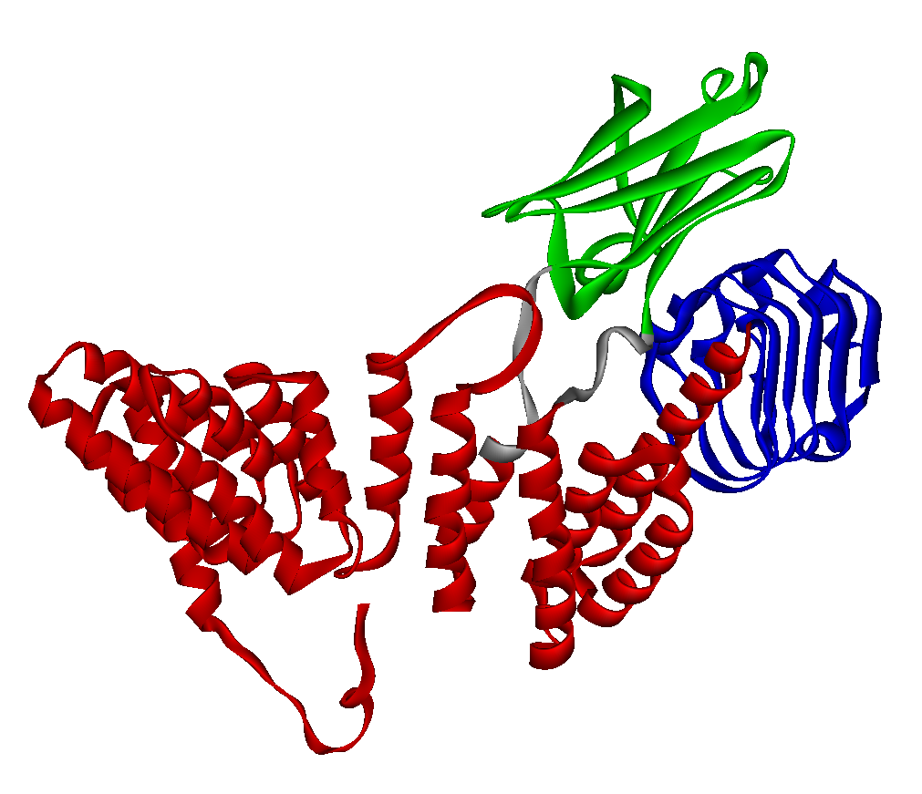
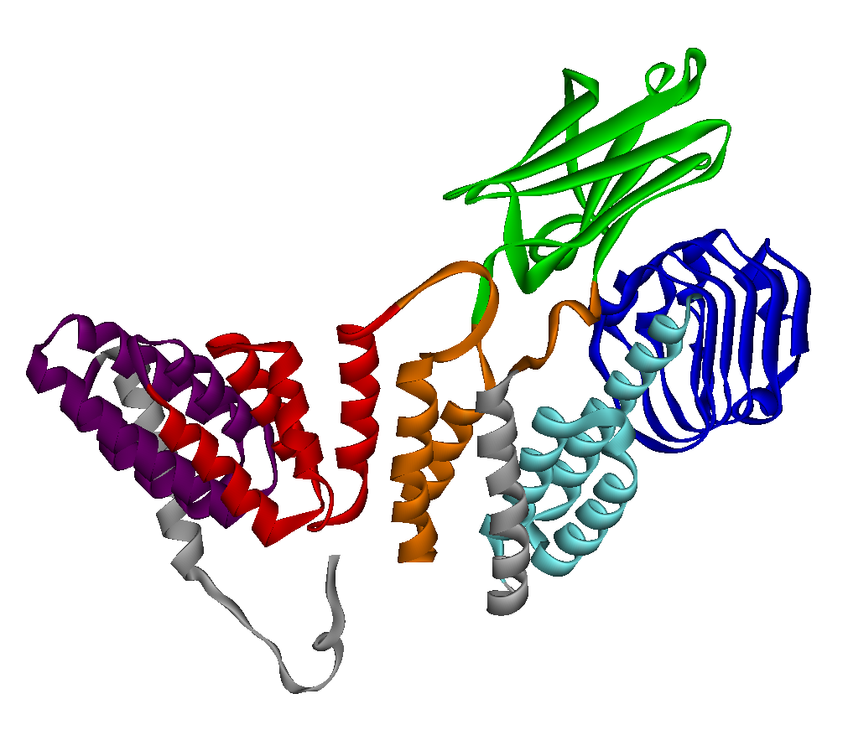
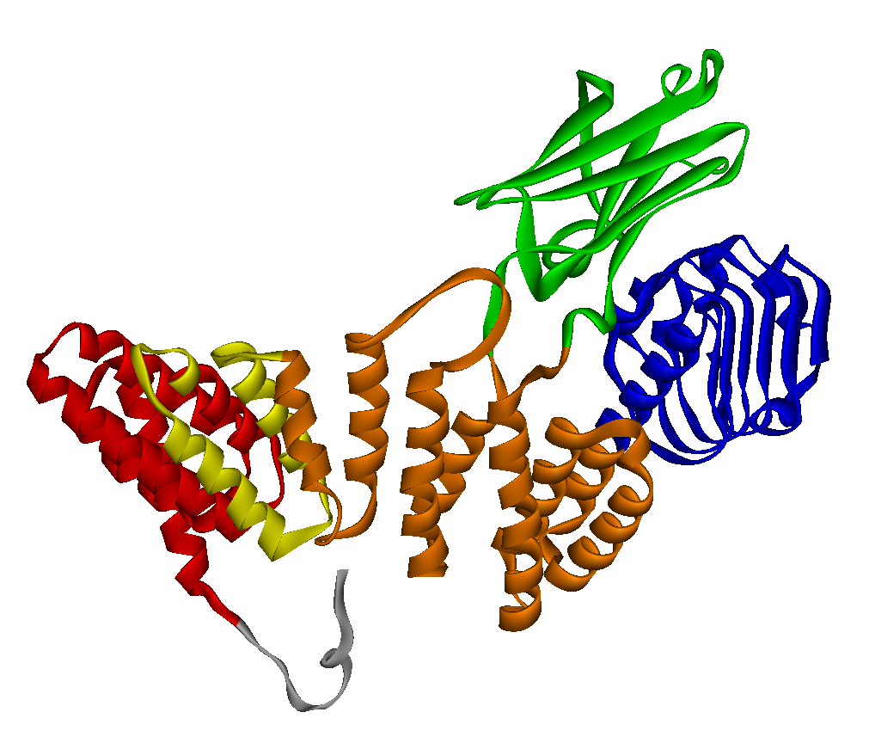
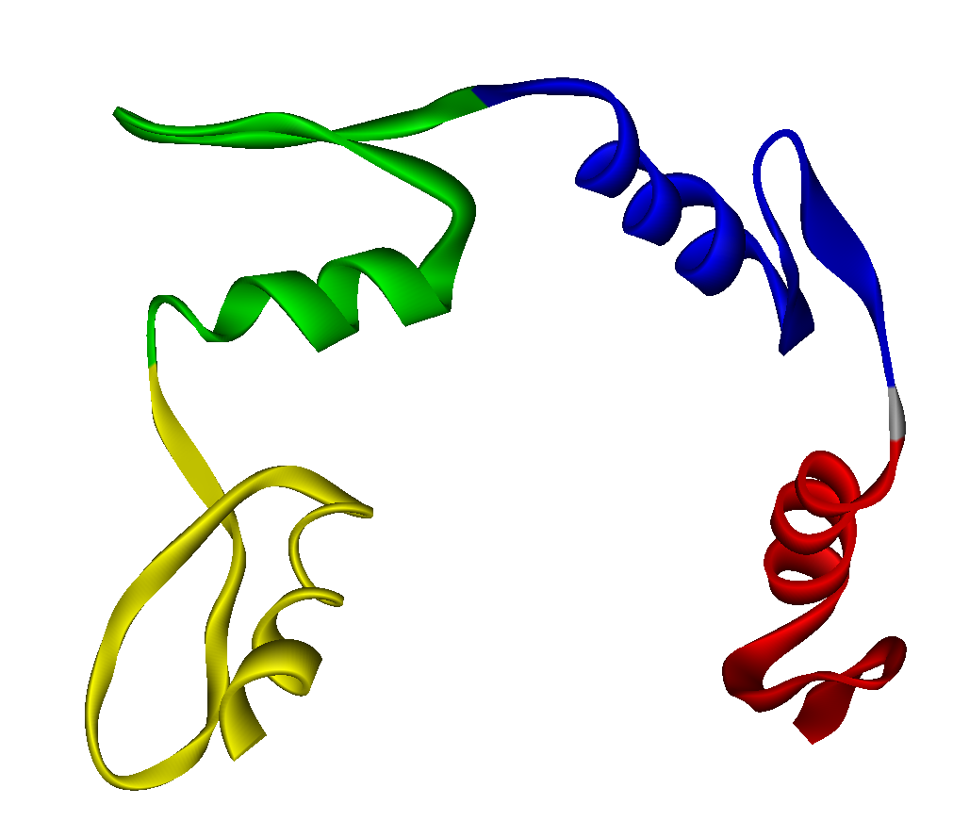
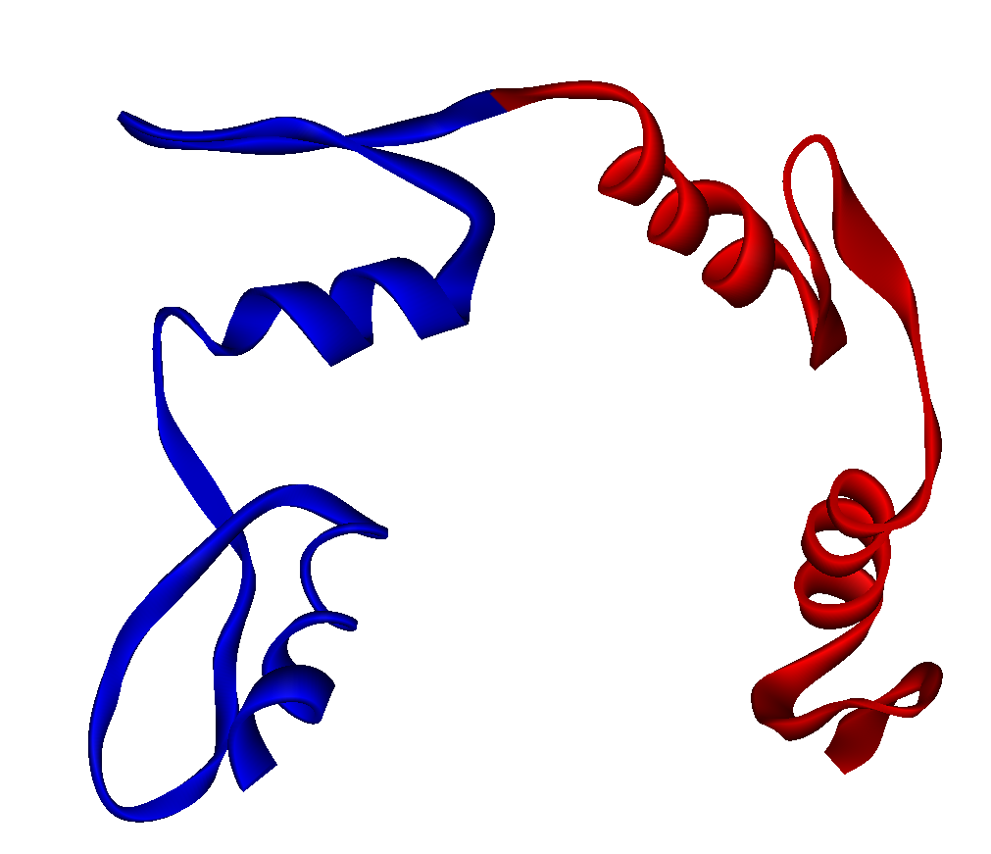
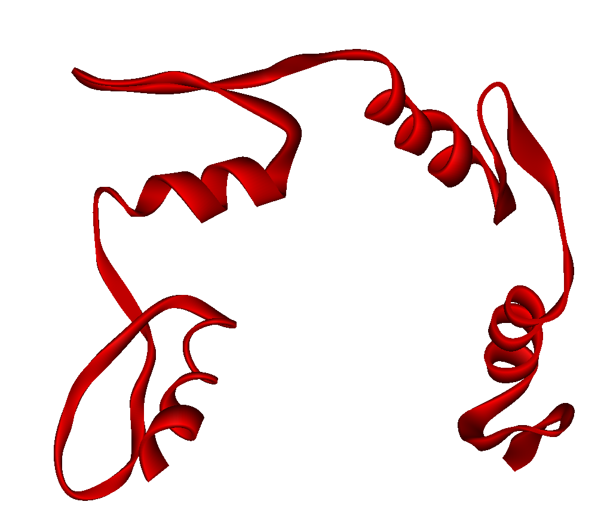
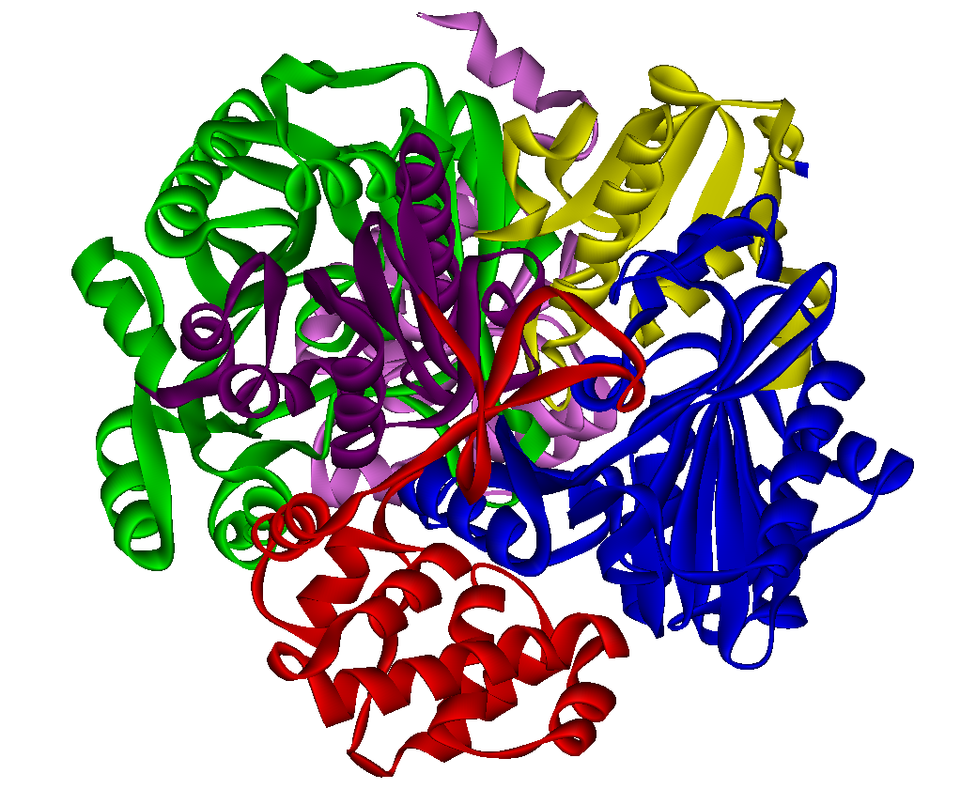
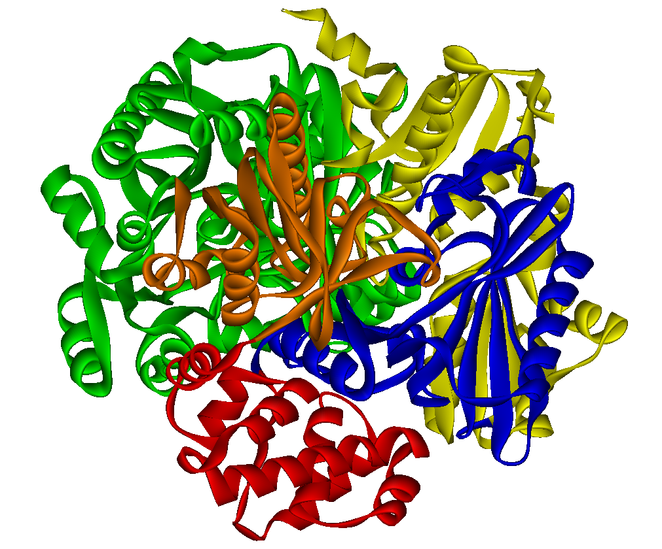
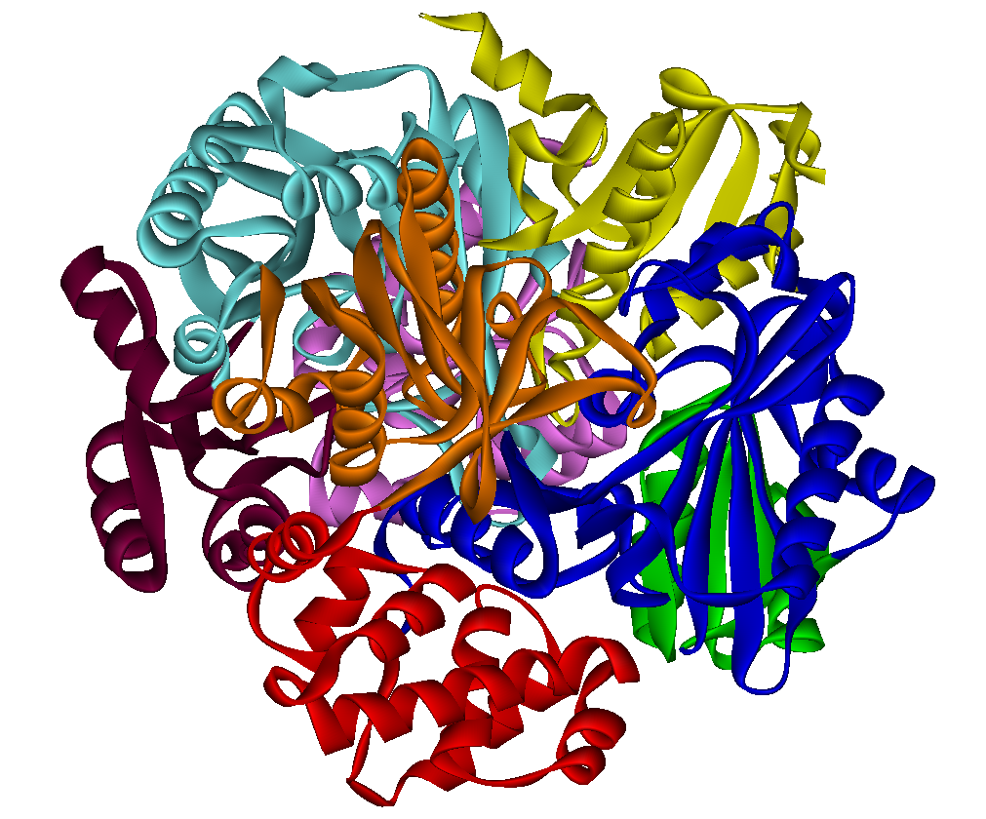
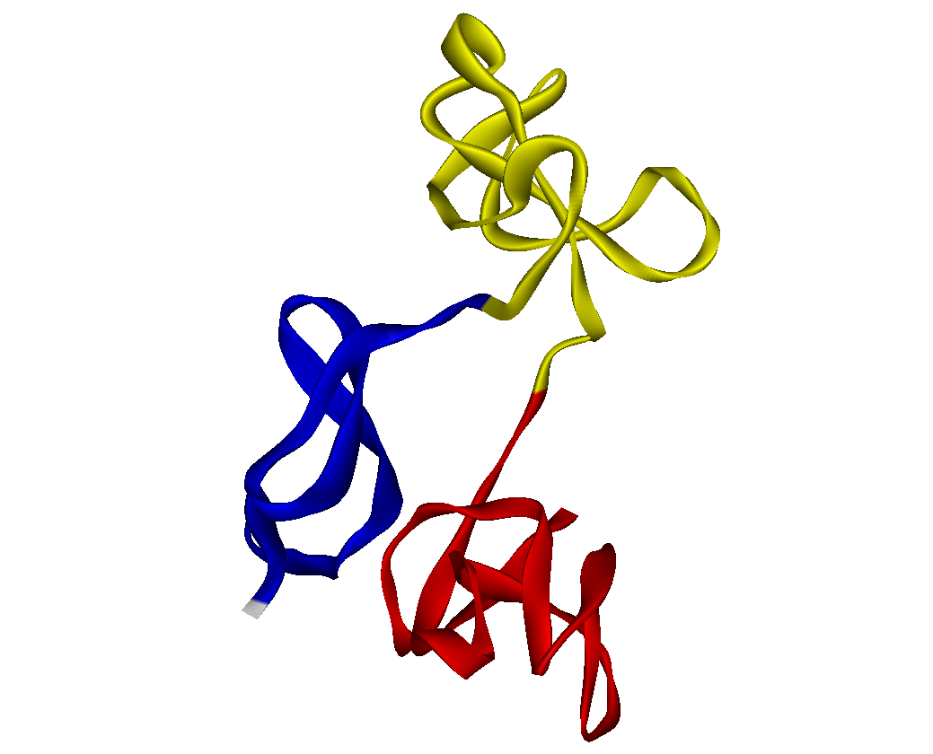
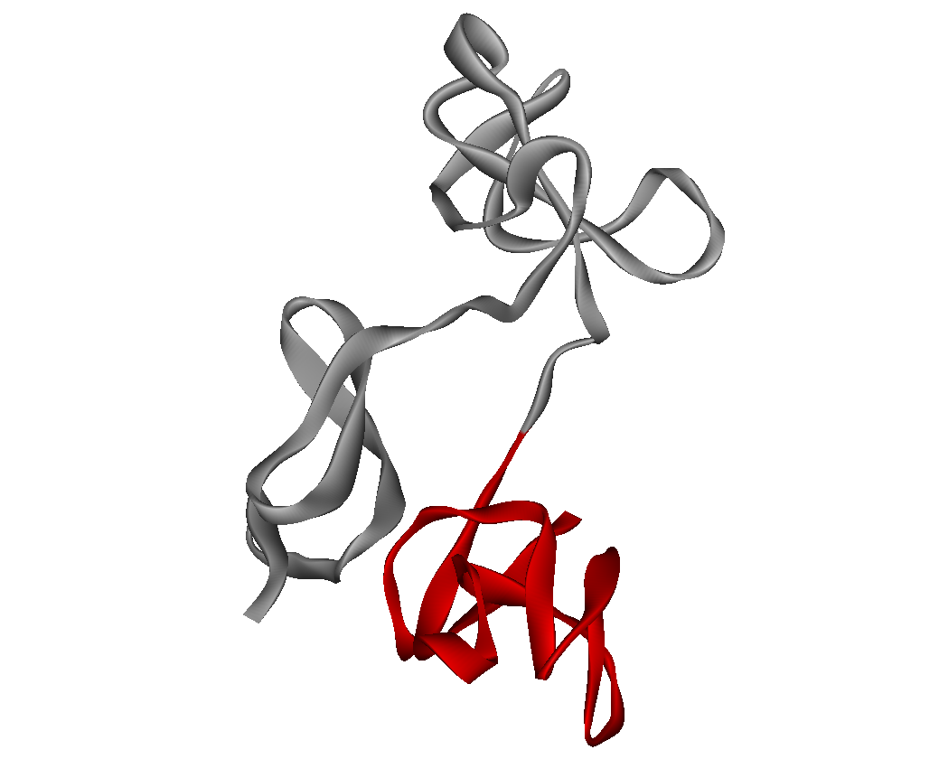
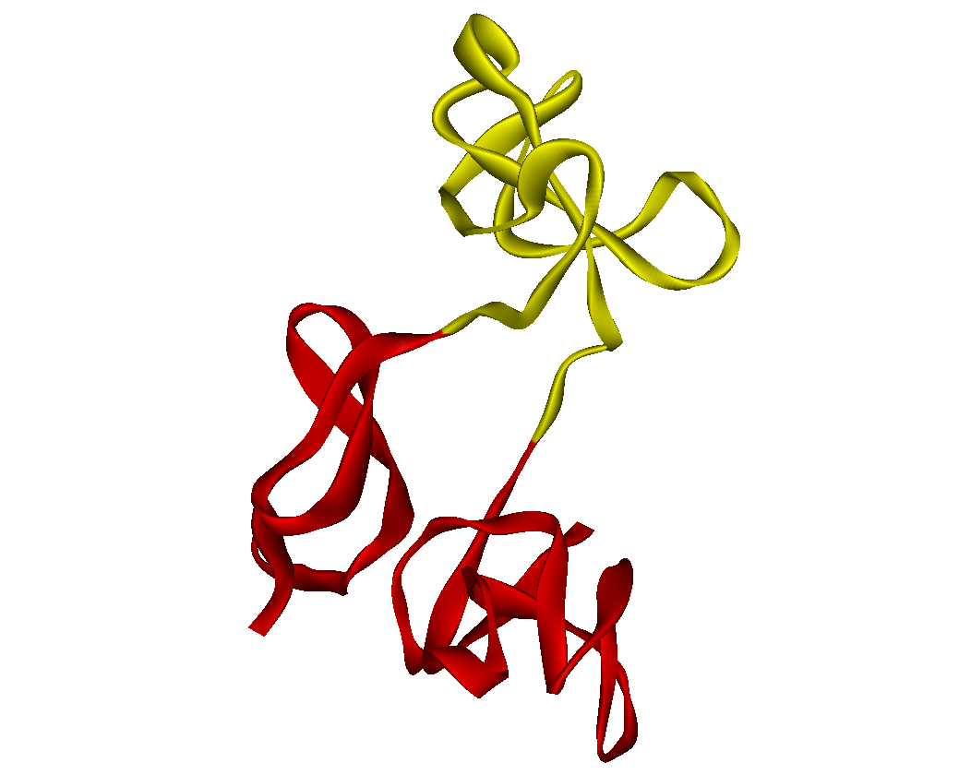
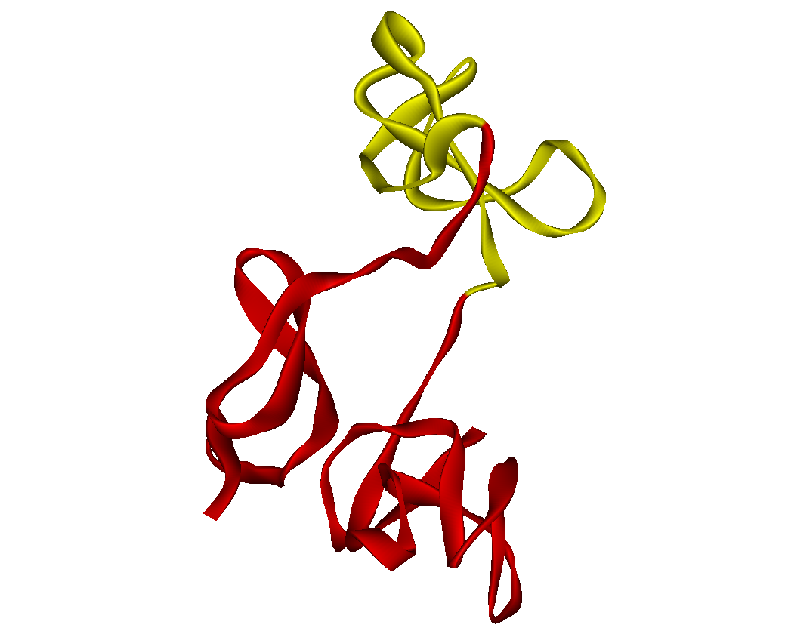
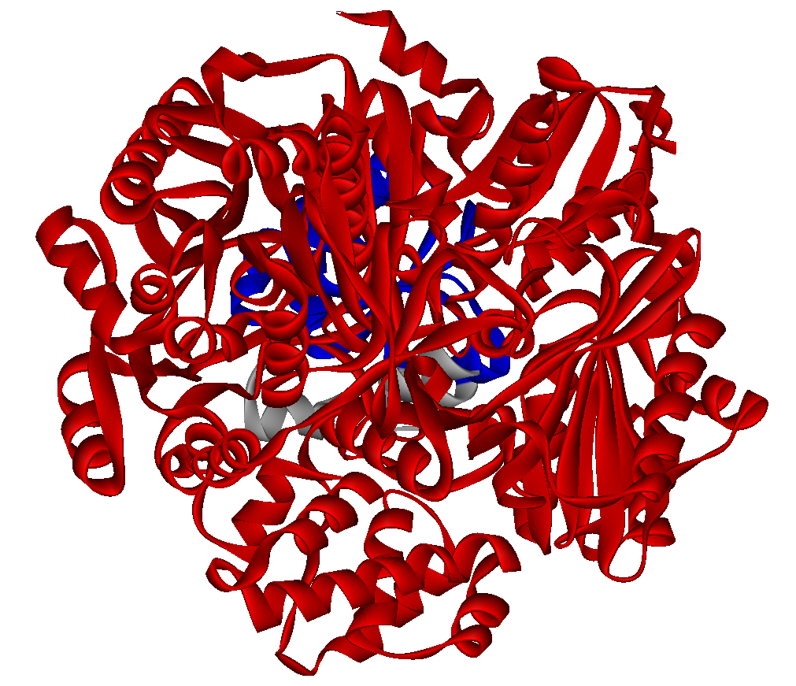
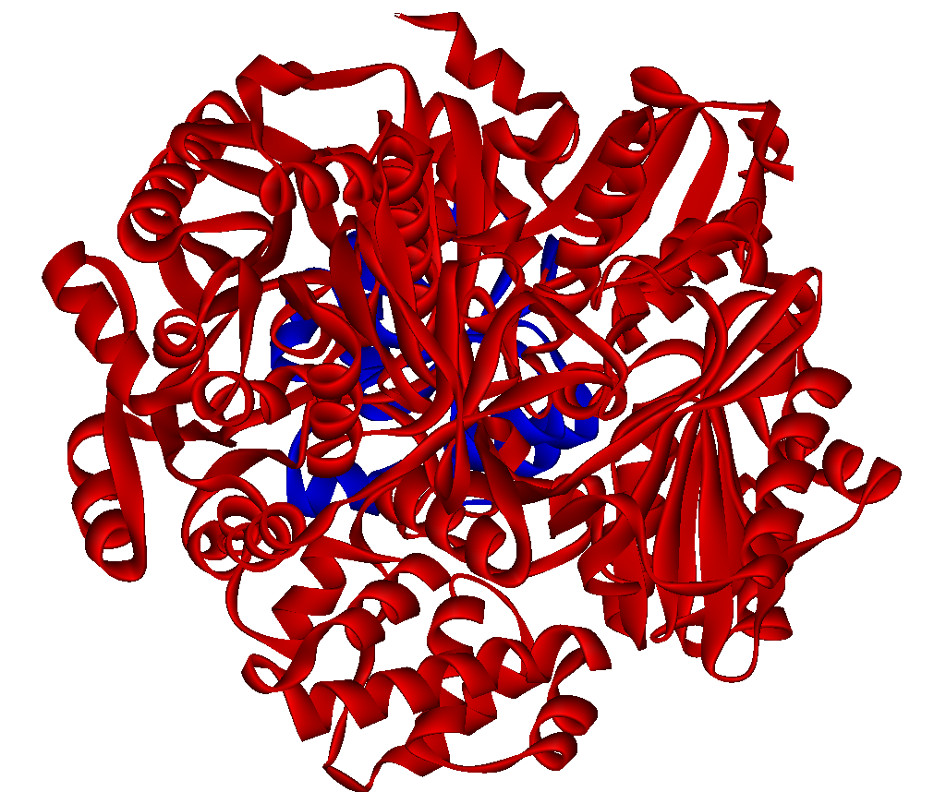
Evaluation of automatic domain assignment methods
Large structures, complex architectures
Structures with issues (all/most methods)
1dcea
Very small simple domains: difficult to separate. Issues: minimum domain size, low contact density
1ubdc
Experts: 3
PUU: 6
NCBI method, PDP,
DomainParser : 5
1bxrc
Experts: 4
NCBI method: 4
DomainParser: 2
PDP, PUU: 1
1e88a
Experts: 6
DomainParser: 5
NCBI methods: 8
Experts: 3
PUU: 1
PDP: 2
NCBI: 2
PUU: 2
PDP: 2
Automated vs Manual Methods

Slide 28
Manual vs. Automatic Consensus
Chains with manual consensus: 375 (80% of entire dataset)
Chains with automatic consensus: 374 (80% of entire dataset)
Chains with consensus (automatic or manual) : 424 (90.6% of entire dataset)
Automatic consensus only
46 chains (10.9% of chains with consensus)
Manual consensus only 47 chains (11.1% of chains with consensus)
Manual and automatic consensus
agree
328 chains
(77.3% of chains with consensus)
Automatic consensus and manual consensus disagree 3 chains (0.7% of chains with consensus)
Automated vs Manual Methods
JMB 2004 339(3), 647-678

Slide 29
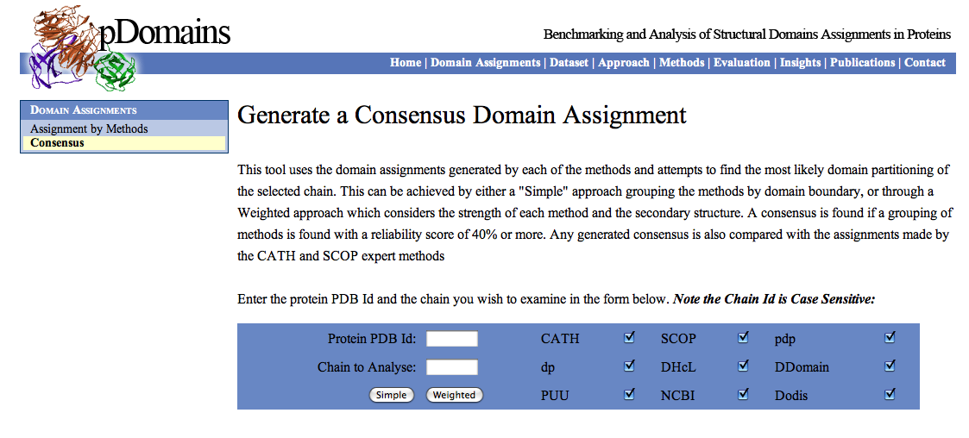
Current Best Solution is to Use a Consensus Based Approach
http://pdomains.sdsc.edu 1CS6 chain A
BMC Bioinformatics 2010, 11:310

